Slide 1
Let's Vote
Presented By Jalon Bailey and Faysal Gebriel

Slide 2
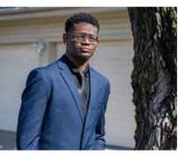


Double Trouble
Name: Jalon Bailey
Majors: Computer Science, Software Engineering
Classification : Senior
Name: Faysal Gebriel
Major: Computer Science
Classification: Freshman

Slide 3

Why do we need online voting ?
Safety
Reduce the risk of tampering
Ensure accurate and verifiable results
Guard against voter suppression
Tech-savvy generation
More voting participation
Engaging younger demographics
Convenience
Cost Efficiency and Environmental Benefits
Faster and More Efficient Election Results.
Accessibility

Slide 4

Voting safely

Slide 5

Point: Voting safely
Cases in Voting in for dead people
Heritage Foundation's Voter Fraud Database of December 2019, found 19 cases since 1997 where Votes cast in the names of deceased people
Election investigators in Georgia found 4 absentee ballots that had been cast in the 2020 election
Case in Voting suppression
reducing the number of early voting days or hours, making it more difficult for people with inflexible work schedules to cast their ballots.
polling places, particularly in minority neighborhoods, have been closed, leading to longer lines and potential disenfranchisement.
Case in inaccurate voting numbers
2000 Butterfly ballot design in Florida bush versus gore
537 votes put him on top
National popular vote: Gore wins 543,895 votes (50,999,897 to Bush's 50,456,002). Electoral college: Bush wins, 271 electoral votes to 267. Florida is the deciding state.

Slide 6
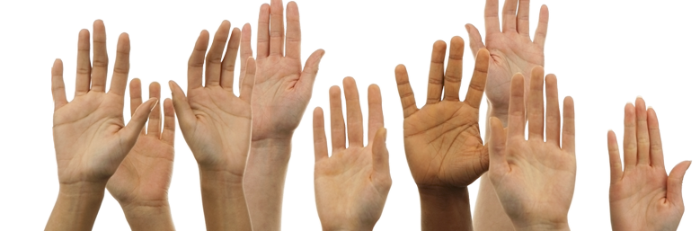
Voting participation in recent years
This Photo by Unknown author is licensed under CC BY-SA-NC.

Slide 7
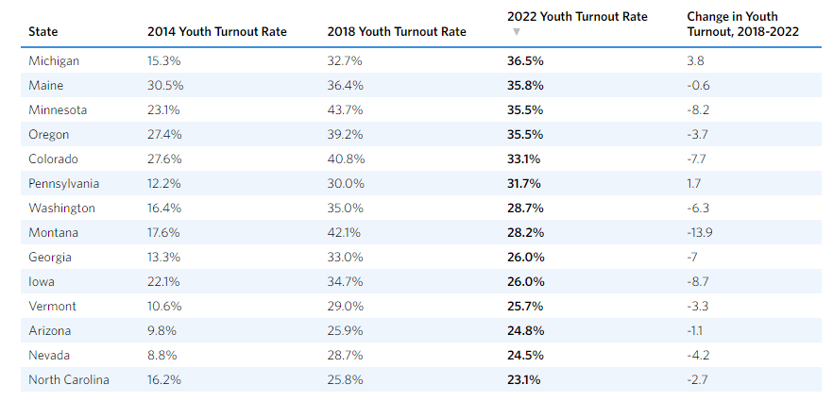
Point: Voting participation in recent years
Voter participation in recent years has received high participation in states that implemented tech in their voting.
For example, Michigan who had the highest youth voting turnout also happens to be a state where there is online voter registration and tries to make it as easy as possible to vote.
On the other hand, states like Montana who notably lack tech in the voting process had a major decrease In voters. If you don’t believe me look at the chart!!

Slide 8

Vote Conveniently

Slide 9

Point: Vote Conveniently
Accessibility
Voters can vote from anywhere with a Wi-Fi connection. This eliminates the need to travel to a polling area which can be beneficial to people who live in rural areas and people with disabilities.
Cost Efficiency & Environmentally Friendly
Voters who would travel long distances can save time and money.
Online voting would also reduce the need for paper ballot and materials leading to more environmental sustainability.
Faster more efficient results
Votes can be reported quickly which in turn reduces the wait time for election outcome.
Reduced wait times
Voting online eliminates the need to wait in a long line at a polling area.

Slide 10

How Can We Implement This?

Slide 11

Implementation
Grabbing Attention
Using a user interface that’s friendly and easy to navigate via mobile or desktop application (Desktop version Mobile version )
For Security
Honey pot tactics
Smart contracts
Unique identifer of user profile
Restricted access to database and server room
Info coming in
Provide details about canidates
Provide potenial poll booth locations
Provide election news – candidates votes so far, speeches,etc..
Provide user only voting history
This Photo by Unknown author is licensed under CC BY-NC-ND.

Slide 12
What are you accomplishing to make this different?
Creating a more user-friendly ENVIRONMENT that guides society into embracing technology, FOSTERING INCLUSIVITY, AND PROMOTING informed decision making

Slide 13
Reference/Bibliography
State-by-State Youth Voter Turnout Data and the Impact of Election Laws in 2022 | CIRCLE (tufts.edu)
Youth Voter Registration Is Up Compared to 2018—Especially in Key Battlegrounds | CIRCLE (tufts.edu)
https://ballotpedia.org/Votes_cast_in_the_names_of_deceased_people
https://thehill.com/homenews/campaign/587483-georgia-investigators-find-four-cases-of-deceased-voters-casting-ballots-in/
https://www.palmbeachpost.com/story/news/history/2020/10/16/2000-election-george-bush-al-gore-and-butterfly-ballots/5938042002/

Slide 14

Thank You

